Slide 1
A Study Of
The Book Of Revelation
October 24, 2021

Slide 2

Revelation 21:12
Revelation 21
“having a wall great and high; having twelve gates, and at the gates twelve angels; and names written thereon, which are (the names) of the twelve tribes of the children of Israel:”

Slide 3
Description of the City
Revelation 21
Having the “glory of God”
Light was like was liked to a “jasper stone” (4:3)
Clear as crystal
Most scholars conclude this is like a diamond
The beauty and grandeur of the city reflect the glory of God
Brilliant light is pure and perfect (22:5)

Slide 4
Description of the City
Revelation 21
Wall was great and high
  Built as protection for ancient cities –
  thick high wall
12 gates – 12 angels at the gates
  People of God – only those who maintained garments may enter. Abundant entrance.
  2 Peter 1:11
Names written on the gates
Names of the 12 tribes of Israel. (cf. Hebrews 9:15; 11:10, 13-16).
  Faithful of OT times in the heavenly city.
  Reuben, Simeon, Levi, Judah, Zebulun, Issachar, Dan, Gad, Asher, Naphtali, Joseph, Benjamin

Slide 5
Revelation 21:13
Revelation 21
“on the east were three gates; and on the north three gates; and on the south three gates; and on the west three gates.”

Slide 6
Revelation 21:14
Revelation 21
“And the wall of the city had twelve foundations, and on them twelve names of the twelve apostles of the Lamb.”

Slide 7
Entrance of the City
Revelation 21
  Entrance from the city was available from four directions.
  3 east – 3 north – 3 south – 3 west
People from every kindred, tongue, people, and nation. (Revelation 5:9; 7:9)
Gates of the ancient cities were closed at night for protection

Slide 8
Entrance of the City
Revelation 21
12 Gates of the heavenly city which are never closed – abundant entrance!
2 Peter 1:11
The gates will not need to be shut because no enemies exist to invade the city.
They have all been cast into the lake of fire (19:20; 20:10, 15; 21:8).

Slide 9
Foundations of the City
Revelation 21
Wall of the city had 12 foundations
  One foundation for every gate
Names of the 12 apostles of the Lamb
  Those of the NT era who will enter the city have also walked by faith
  Built by the gospel that had been preached
  Peter, Andrew, James, John, Philip, Bartholomew, Thomas, Matthew, James the son of Alphaeus, Thaddaeus, Simon the Canaanite, Mathias (?)
  John would have seen his own name!

Slide 10
Revelation 21:15
Revelation 21
“And he that spake with me had for a measure a golden reed to measure the city, and the gates thereof, and the wall thereof.”

Slide 11
Revelation 21:16
Revelation 21
“And the city lieth foursquare, and the length thereof is as great as the breadth: and he measured the city with the reed, twelve thousand furlongs: the length and the breadth and the height thereof are equal.”

Slide 12
Revelation 21:17
Revelation 21
“And he measured the wall thereof, a hundred and forty and four cubits, (according to) the measure of a man, that is, of an angel.”

Slide 13
Measuring the City
Revelation 21
Golden reed (or rod) was used to measure
Ensure “perfection” of the city (in its provisions)
The gates (means of entrance)
The walls (security of protection)
Measurement was a “perfect cube”
Its length, breadth, height was 12,000 furlongs (1,500 miles)
12 = people of God 1,000 x ten = complete full number
Literal? NO! Could not fit into Palestine!

Slide 14
Measuring the City
Revelation 21
Literal measurement? (1 Kings 6:20)
Its staggering dimension is simply to depict the fact that heaven will be so enormous it will adequately contain all the saved!
Wall measure 144 cubits (thickness?) 12x12
According to the “measure of a man”
Indicates, in an apocalyptic way, full security for the people who dwell within its confines. Ultimate “holy place”

Slide 15
Revelation 21
“Victory in Heaven”
I. Perfect Fellowship With God (verses 1-8)
  God’s people who overcame will be with God (verses 1-7)

Slide 16
Revelation 21
God’s people who overcame will be with God (verses 1-7)
1. New heaven and new earth (verse 1)
2. No more sea (verse 1)
3. New Jerusalem (verse 2)
4. God dwells with them (verse 3)
5. Former things passed away (verse 4)
6. Drink the water of life freely (verse 6)
7. Inheritance as God’s children (verse 7)

Slide 17
Revelation 21
“Victory in Heaven”
I. Perfect Fellowship With God (verses 1-8)
  God’s people who overcame will be with God (verses 1-7)
  Those who are not God’s people will not be there (verse 8)

Slide 18
Revelation 21
“Victory in Heaven”
Perfect Fellowship With God (verses 1-8)
The New Jerusalem (verses 9-27)
  Angel showed John the great city (verses 9-11)
  Exterior of the city (verses 12-21)
  Interior of the city (verses 22-27)

Slide 19
Revelation 21:18
Revelation 21
“And the building of the wall thereof was jasper: and the city was pure gold, like unto pure glass.”

Slide 20
Revelation 21:19
Revelation 21
“The foundations of the wall of the city were adorned with all manner of precious stones. The first foundation was jasper; the second, sapphire; the third, chalcedony; the fourth, emerald;”

Slide 21
Revelation 21:20
Revelation 21
“the fifth, sardonyx; the sixth, sardius; the seventh, chrysolite; the eighth, beryl; the ninth, topaz; the tenth, chrysoprase; the eleventh, jacinth; the twelfth, amethyst.”

Slide 22
Revelation 21:21
Revelation 21
“And the twelve gates were twelve pearls; each one of the several gates was of one pearl: and the street of the city was pure gold, as it were transparent glass.”

Slide 23
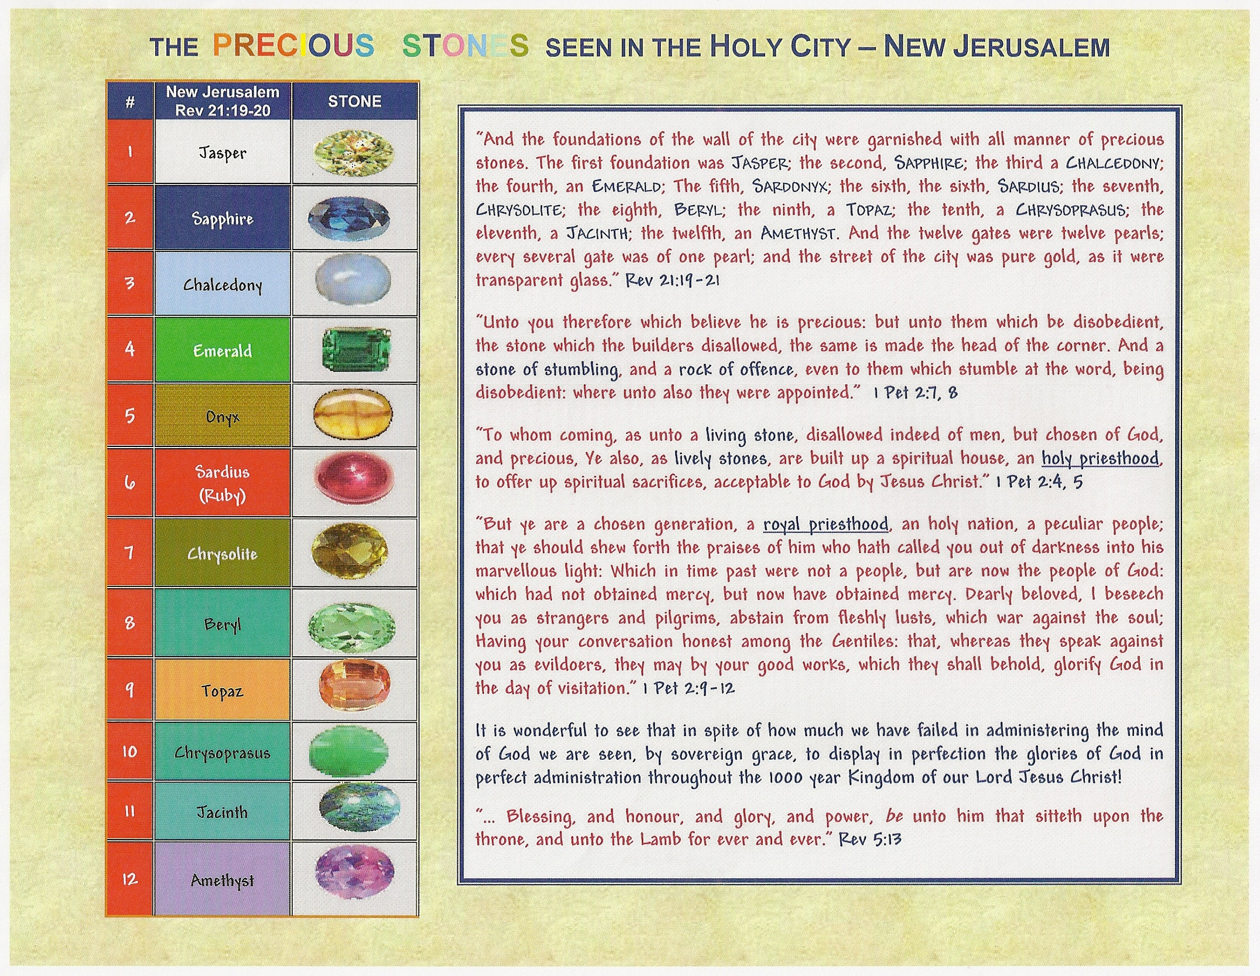

Slide 24
Construction of the Walls
Revelation 21
What we read helps the reader to envision heaven as beautiful and precious.
Wall was built of jasper – like a diamond
City was pure gold – like clear glass
Foundations of the wall of the city adorned with all kinds of “precious stones”
  First – jasper {diamond}
  Second – sapphire {clear blue stone}
  Third – chalcedony {green carbonization of copper}

Slide 25
Construction of the Walls
Revelation 21
Foundations of the wall of the city adorned with all kinds of “precious stones”
  Fourth – emerald {greenest of stones}
  Fifth – sardonyx {onyx-broken white – layers of red/brown}
  Sixth – sardius {red stone}
  Seventh – chrysolyte {yellow amber}
  Eighth – beryl {tinged of yellow, blue and green}
  Ninth – topaz {yellowish green color}

Slide 26
Construction of the Walls
Revelation 21
Foundations of the wall of the city adorned with all kinds of “precious stones”
  Tenth – chrysoprase {pale green}
  Eleventh – jacinth {rich blue color}
  Twelfth – amethyst {more brilliant}

Slide 27
Construction of the Walls
Revelation 21
12 gates were 12 pearls
Each individual gate was 1 pearl
Been said “pearls” highest ranking among all precious stones
Street of city like pure gold
Transparent like glass
Glorious entrance for those who dwelled there
Glorious light of God reflected its shining appearance

Slide 28
Revelation 21:22
Revelation 21
“And I saw no temple therein: for the Lord God the Almighty, and the Lamb, are the temple thereof.”

Slide 29
Revelation 21:23
Revelation 21
“And the city hath no need of the sun, neither of the moon, to shine upon it: for the glory of God did lighten it, and the lamp thereof (is) the Lamb.”

Slide 30
Revelation 21:24
Revelation 21
“And the nations shall walk amidst the light thereof: and the kings of the earth bring their glory into it.”

Slide 31
Revelation 21:25
Revelation 21
“And the gates thereof shall in no wise be shut by day (for there shall be no night there):”

Slide 32
Revelation 21:26
Revelation 21
“and they shall bring the glory and the honor of the nations into it:”

Slide 33
Glory of the City
Revelation 21
Those who hold to the earthly temple, earthly Jerusalem, as the goal of this book, these passages destroy that theory!
John saw NO temple there
Lord God and the Lamb are the temple!
  NT construction of a building unnecessary
  Christians are the temple (1 Corinthians 3:16;
  Ephesians 2:19-22)
  However, following final judgment, God and the Lamb are the temple!
  Theories of our day have it backwards!
  In the new heaven and earth, GOD is the temple!
  Fellowship is direct and constant!

Slide 34
Glory of the City
Revelation 21
City had no need of the sun, neither of the moon – why?
The glory of God gives its light!
Lamb is the light there!
  The light of God now shines through His word – Psalms 119:104-105, 130
  But in the new order the light will be from the glory of God’s presence!
  No need of the sun – daylight or the moon – nightly reflector
  Clearly shows this is a DIFFERENT place than the earth!

Slide 35
Glory of the City
Revelation 21
Glory of the New Jerusalem is so overwhelming that all other glories fade into it and are meaningless by comparison!
In view of verse 27 it is obvious that the nations and kings of the earth that walk in the light of this city will consist of people who have been redeemed by the blood of the Lamb. (5:9; 7:9).
Gates of the city will never be shut at all by day – Why?
No night there!
No enemies to invade the city
Heaven will have continuous light

Slide 36
Glory of the City
Revelation 21
Those who have obeyed the word of God, Christ called them the “salt and light” of the world (Matthew 5:14-16)
We were assured earlier their “works followed them” (14:13)
Bring glory and honor into heaven by that obedient life
Stand as a living testimony that God did not place on man anything went beyond his capacity to accomplish

Slide 37
Revelation 21:27
Revelation 21
“and there shall in no wise enter into it anything unclean, or he that maketh an abomination and a lie: but only they that are written in the Lamb's book of life.”
Revelation19:20; 20:10, 15; 21:8

Slide 38
Some Will Never See It!
Revelation 21
God gives His divine promise that under no circumstances will some be allowed to enter:
  Anything that defiles
  Works abominations
  Makes lies
  Those not written in the Lamb’s Book of Life
  Men had two choices in life (Matthew 7:13-14)
  Those who choose the “broad way” cannot enter into this city!

Slide 39
Closing Notes …
Revelation 21
Some excellent Bible students see in these last chapters the church on earth.
See God as providing every need for the ones who have been “washed in the blood of the Lamb.”
These truths are taught in other scriptures, but don’t fit the context of Revelation’s theme and purpose.
Here are some reasons to consider …
(Robert Harkrider, Revelation, Truth Commentaries, page 310)

Slide 40
Closing Notes …
Revelation 21
1. Chronology of the text follows the final judgment scene rather than occurring before. (20:11-15)
2. Former things are “passed away” (21:4), earth and heaven have “fled away” (20:11), and John saw a “new heaven and earth” (21:1).
3. Drinking of the water of life is occurring while others are in the lake of fire, the second death (20:15; 21:6-7; 21:8).
(Robert Harkrider, Revelation, Truth Commentaries, page 310)

Slide 41
Closing Notes …
Revelation 21
4. The rewards are comparable to those spoken earlier in the book as blessings after death. The faithful:
  Wear robes of white coming out of tribulation (6:11; 7:4)
  Serve God night and day in His temple (7:14-17); His temple is heaven (11:19).
  Are in heaven where God is the temple (21:22). On earth church, He dwells in us – then we dwell in His presence!
Experience neither hunger, thirst, nor heat of the sun upon them (11:16).
(Robert Harkrider, Revelation, Truth Commentaries, page 310)

Slide 42
Closing Notes …
Revelation 21
4. The rewards are comparable to those spoken earlier in the book as blessings after death. The faithful:
  Shall be fed by the Lamb and He shall wipe away all tears (11:17).
  Shall eat of the tree of life which is in the paradise of God (2:7).
  Will be given a crown of life and not be hurt of the second death (2:10-11).
  Shall see God’s face (22:4); cannot be done on earth
  (1 John 4:12).
Shall reign forever and ever whereas before judgment they reigned a 1,000 years (22:5).
(Robert Harkrider, Revelation, Truth Commentaries, page 310)

